Slide 1
Technology Plan
CampManager
MEINF UDL – EPS 2022-2023

Slide 2

Table Of Contents
Executive Summary
ICT SWOT
Strategy
Costs and Earnings

Slide 3
Executive Summary
Analyse the technological plan of the CampManager company
Study how to use ICT to achieve the objectives
Internal and external ICT situation of the company
More technological resources are needed
Reorientation Strategy
Cybersecurity
New Communication Methods
AI
Analysis of costs and earnings
3
Tech Plan
Notes:
Primer punt: Aixo es l'objectiu del document
2n punt: Proces realitzat dins del document
3r punt resultats

Slide 4
Phases Of The Tech Plan
Vision
Analysis
Management
Recommendations
Project initialization
Evaluation of the situation
Documentation and concretion
Analysis of the ICT situation
Development of scenarios
Development vision and management ICT
Development of the Technology Plan
Identification of ICT projects
Roadmap
Development of the "business case
Communication plan

Slide 5
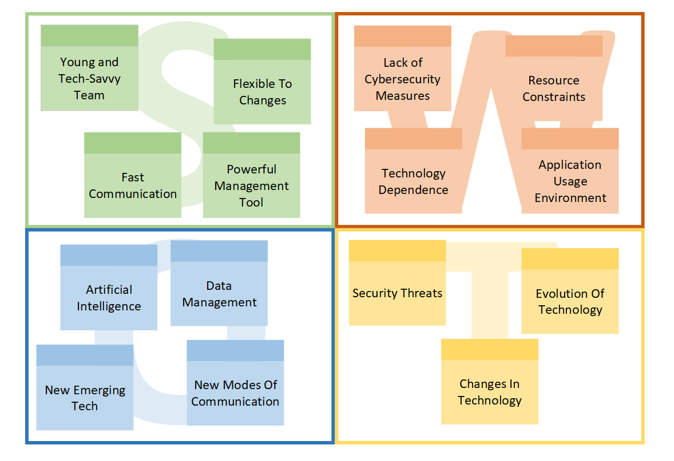
ICT SWOT

Slide 6
Strategy
Reorientation Strategy
Investigation and Implementation of Cybersecurity mechanisms
Use emerging technologies to provide our services in more locations
Study and implementation of Artificial Intelligence applications

Slide 7
Activities and Resources
Activity | Resources | Timing | Cost
Identify potential new niches and markets | Social Media, Tools for Customer Surveys | 6 months | 25.000€
New Product Development | Software Development Tools, Servers | 1,5 years | 50.000€
Evaluate alternative vendors | Computers | 6 months | 6.000€

Slide 8
Activities and Resources
Activity | Resources | Timing | Cost
Security Implantantation | Firewall, VPN, Network Elements, Enterprise Computers | 2 years | 80.000€
Annual cybersecurity audits | Company ICT Elements | Permanent | 5.000€
IA features development | Computers, Platforms to Train AI models, Software Development Control Tools | 2 years | 70.000€

Slide 10

Thank You For Your Attention!

